Slide 1
CSCI561 FALL 2017 Week 4 Discussion
Prof Sheila Tejada stejada@usc.edu
Prof Wei-min Shen shen@isi.edu
Prof Ning Wang nwang@ict.usc.edu

Slide 2
Beyond Classical Search
Adversarial search
MiniMax search
Alpha-beta pruning
Hill climbing
Local beam search
Simulated annealing
Genetic algorithm
Notes:
Local beam search with k = 1 is hill-climbing search.
Local beam search with one initial state and no limit on the number of states retained, resembles breadth-first search in that it adds one complete layer of nodes before adding the next layer. Starting from one state, the algorithm would be essentially identical to breadth-first search except that each layer is generated all at once.
Simulated annealing with T = 0 at all times: ignoring the fact that the termination step would be triggered immediately, the search would be identical to first-choice hill climb- ing because every downward successor would be rejected with probability 1. (Exercise may be modified in future printings.)
Simulated annealing with T = ∞ at all times is a random-walk search: it always accepts a new state.
Genetic algorithm with population size N = 1: if the population size is 1, then the two selected parents will be the same individual; crossover yields an exact copy of the individual; then there is a small chance of mutation. Thus, the algorithm executes a random walk in the space of individuals.

Slide 3
Adversarial search
MAX
x
o
x
o
x
o
win
lose
x
o
x
x
o
x
x
o
x
MIN
draw
x
o
x
o
x
o
x
o
x
o
x
o
x
o
x
x
o
x
x
o
x
x
o
x
x
o
x
x
o
x
MAX
x
o
x
x
o
x
o
o
x
o
x
o
o
x
o
x
o
o
o
o
x
o
x
o
o
x
o
o
x
o
x
o
x
x
o
x
x
o
x
x
o
x
x
o
x
o
o
x
o
o
x
x
o
x
o
x
o
x
x
o
x
x
o
o
x
o

Slide 4
Minimax algorithm
MAX
6
MIN
6
-8
-9
15 10 6 12 -8 7 5 25 -9

Slide 5
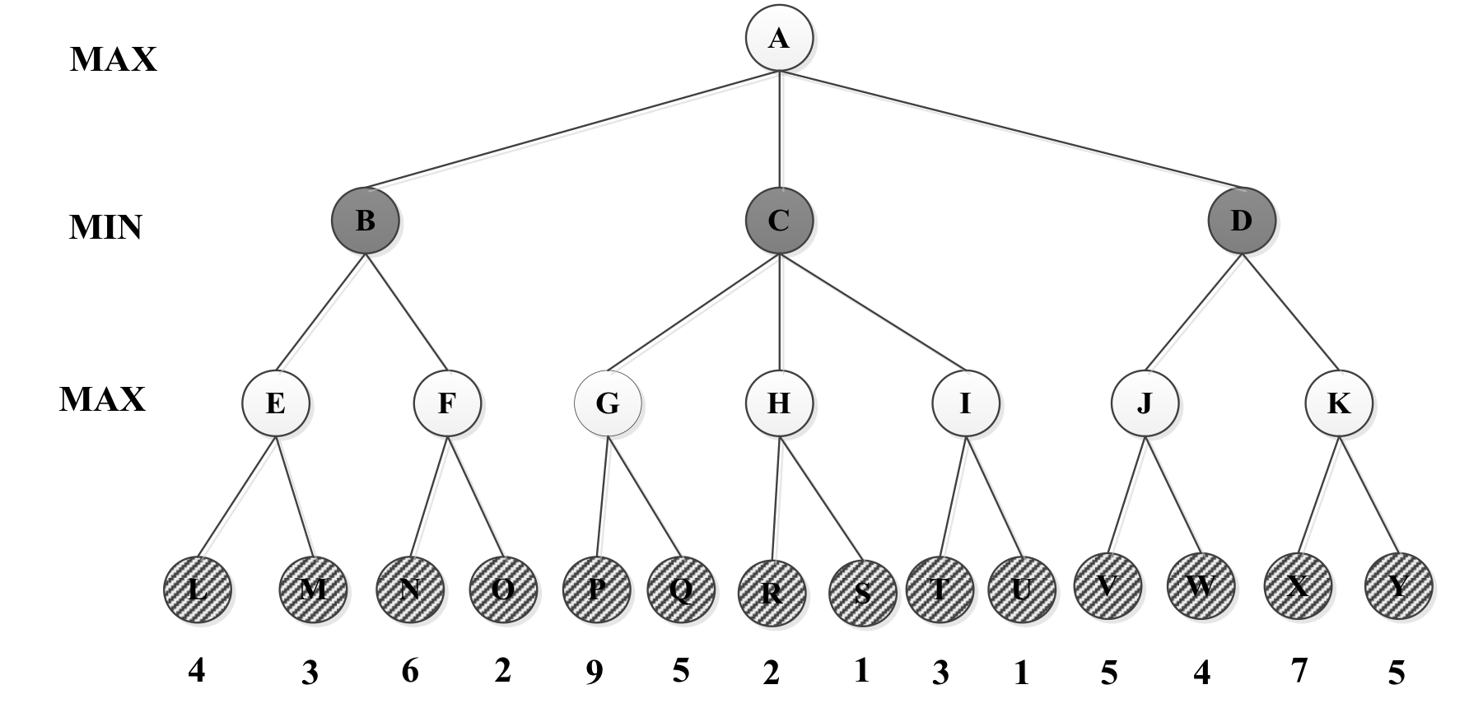
=5
β = +∞
v = 5
=-∞
β = +∞
v = -∞
=4
β = +∞
v = 4
= 4
β = +∞
v = ∞
= 4
β = 9
v = 9
= 4
β = 9
v = 2
= 4
β = +∞
v = ∞
=-∞
β = +∞
v = ∞
= 4
β = 5
v = 5
=-∞
β = 4
v = 4
=4
β = ∞
v = -∞
=9
β = ∞
v = 9
=4
β = +∞
v = 4
=-∞
β = +∞
v = -∞
=4
β = +∞
v = 4
=4
β = 5
v = -∞
=4
β = 9
v = -∞
=4
β = ∞
v = -∞
=4
β = 5
v = 7
=-∞
β = 4
v = -∞
=4
β = 9
v = 2
=5
β = ∞
v = 5
=-∞
β = 4
v = 6
Max Node
Min Node

Slide 6
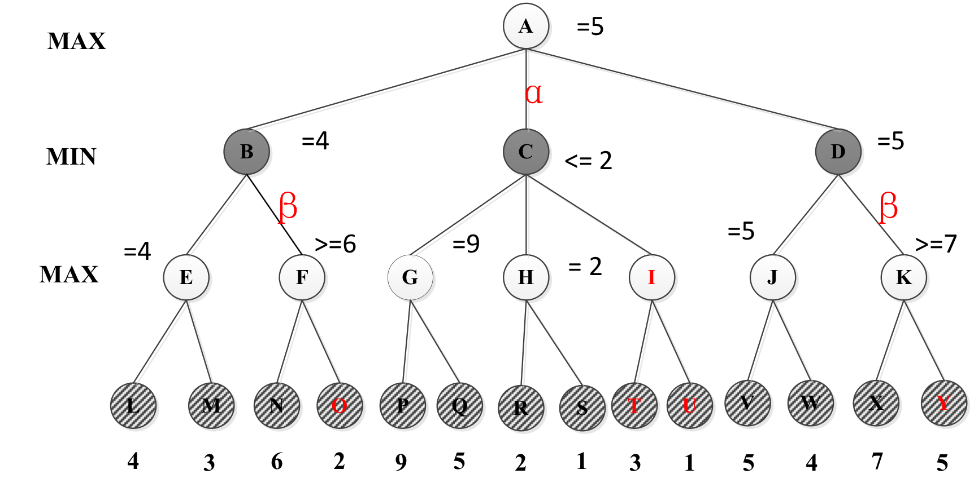

Slide 7
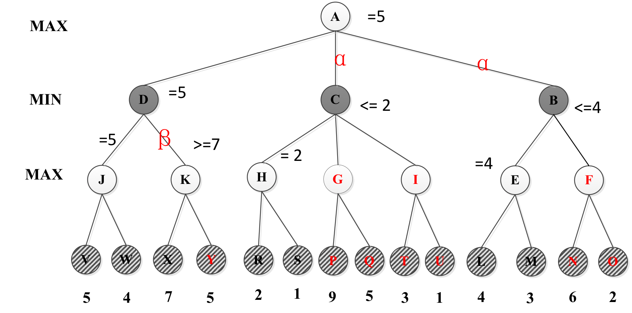

Slide 8
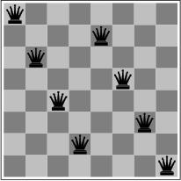
Hill Climbing
What are the advantages and disadvantages of classical hill-climbing?
Can you think of real-world examples where hill-climbing would be particularly good?
What about bad?
Notes:
The success of hill climbing depends very much on the shape of the state-space land- scape: if there are few local maxima and plateaux, random-restart hill climbing will find a good solution very quickly. On the other hand, many real problems have a landscape that looks more like a widely scattered family of balding porcupines on a flat floor, with miniature porcupines living on the tip of each porcupine needle, ad infinitum. NP-hard problems typi- cally have an exponential number of local maxima to get stuck on. Despite this, a reasonably good local maximum can often be found after a small number of restarts.

Slide 9
Local beam search
1. Start with k randomly generated nodes.
2. Generate all successors of each of the k.
3. Keep the best k out of the them.
4. Repeat till goal or stop condition reached
K=2
K=2
Notes:
What is local beam search?
It begins with k randomly generated states. At each step, all the successors of all k states are generated. If any one is a goal, the algorithm halts. Otherwise, it selects the k best successors from the complete list and repeats.
At first sight, a local beam search with k states might seem to be nothing more than running k random restarts in parallel instead of in sequence. In fact, the two algorithms are quite different. In a random-restart search, each search process runs independently of the others. In a local beam search, useful information is passed among the parallel search threads. In effect, the states that generate the best successors say to the others, “Come over here, the grass is greener!” The algorithm quickly abandons unfruitful searches and moves its resources to where the most progress is being made.
In its simplest form, local beam search can suffer from a lack of diversity among the k states—they can quickly become concentrated in a small region of the state space, making the search little more than an expensive version of hill climbing. A variant called stochastic beam search, analogous to stochastic hill climbing, helps alleviate this problem. Instead of choosing the best k from the the pool of candidate successors, stochastic beam search chooses k successors at random, with the probability of choosing a given successor being an increasing function of its value. Stochastic beam search bears some resemblance to the process of natural selection, whereby the “successors” (offspring) of a “state” (organism) populate the next generation according to its “value” (fitness).

Slide 10
Simulated annealing
The AIMA book says that simulated annealing is complete (page 125).
In real-world applications will that be true?
Why or why not?

Slide 11
The Genetic Algorithm Cycle
New Population
Fitness
Selection
Mutation
Crossover
Notes:
Summary of the previous steps to the model.
Populations are continuously produced, going round the outer loop of this diagram, until the desired amount of optimisation has been achieved.

Slide 12
What you should know( WEEK4)
What are the characteristics of local search? Is it complete? Optimal? Time and Space complexity?
What problem domains are well-suited to each type of search technique? Ill-suited? Why?
Know how to compare their performance in general and in a specific domain or problem.
What are the characteristics of Adversarial Search? Why is meta-reasoning important in this type of search?

Slide 13
Want more?
Check out these demos:
http://toddwschneider.com/posts/traveling-salesman-with-simulated-annealing-r-and-shiny/
http://codecapsule.com/2010/04/06/simulated-annealing-traveling-salesman/
http://www.biostat.jhsph.edu/~iruczins/teaching/misc/annealing/animation.html
http://math.hws.edu/eck/jsdemo/jsGeneticAlgorithm.html
http://rednuht.org/genetic_walkers/
http://rednuht.org/genetic_cars_2/
Alpha-beta search demo:
https://www.yosenspace.com/posts/computer-science-game-trees.html

